Slide 1

Brief Introduction to My Work
Name: Xu Xinhang
Date :20231201

Slide 2
Nonthermal electron emission analysis

Slide 3

1
Research Introduction
2
Electron cyclotron emission model
3
Kinetic simulation model
4
application case
5
Summary

Slide 4
Introduction：motivation
Abnormal electron cyclotron emission
Character time scale: ms
time [s]
In the early stage of discharge, there is a peak structure on ece, and the peak contains step structure

Slide 5

Introduction：motivation
Abnormal electron cyclotron emission
Character of abnormal ECE
1
2
$${low n}_{e}$$
High emission
Optica thin 𝜏<1
Non-thermal electrons
Electron cyclotron
simulation
Kinetic
simulation
During density decrease process,
Cyclotron radiation rises exponentially

Slide 6
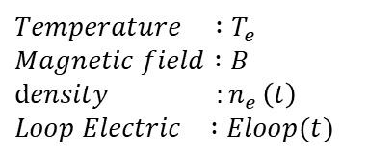
Introduction：research methods
physical models
drive
f
output
Background parameters
Kinetic model
ECE signal evolution
ECE numerical diagnose
$$Temperature :T_{e}$$
$$Magnetic field :B$$
$$density {:n}_{e}\left(t\right)$$
$Loop Electric$ $:Eloop(t)$
Small angle collision
Big angle collision
Magnetic turbulence
Radiation damping
Electric acceleration
…
Emission
Absorption
Ray tracing

Slide 7
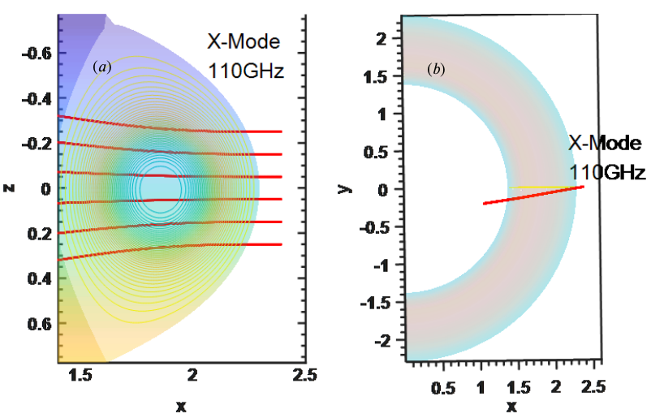
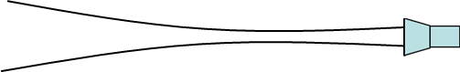
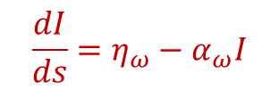
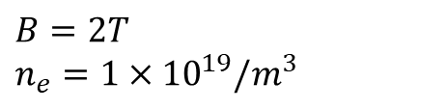
ECE numerical model
Receive path
Ray tracing of different antenna
$$B=2T$$
$$n_{e}=1×{10}^{19}/m^{3}$$
$$\frac{dI}{ds}=η_{ω}−α_{ω}I$$
Side view
Top view

Slide 8
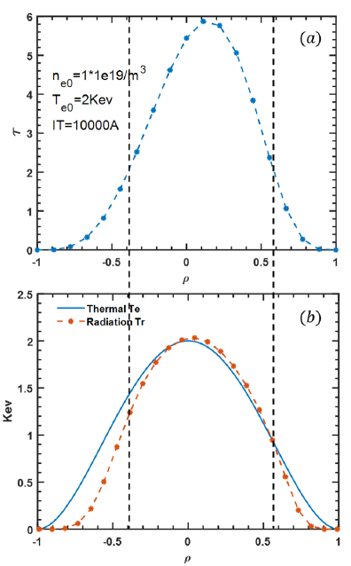
ECE model
Thermal electron distribution test
Thermal electron distribution
Optical thickness
Optical Thick

Slide 9
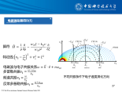
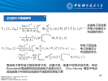
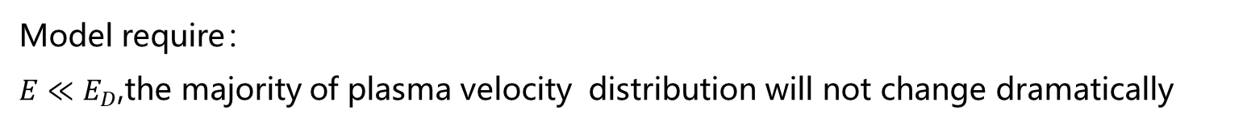
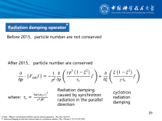
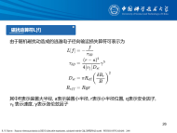

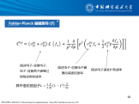
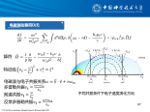
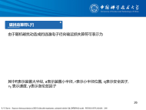
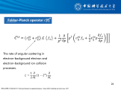
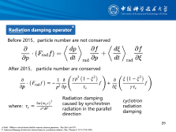
Kinetic simulation model
Background :
infinity uniform static electric field and static magnetic field
Electron source operator
Fokker-Plank operator
EMW diffusion operator
synchrotron radiation backreaction
Stochastic Magnetic operator
Avalanche operator
Electric Field Operator
Model require：
$E≪E_{D}$,the majority of plasma velocity distribution will not change dramatically

Slide 10
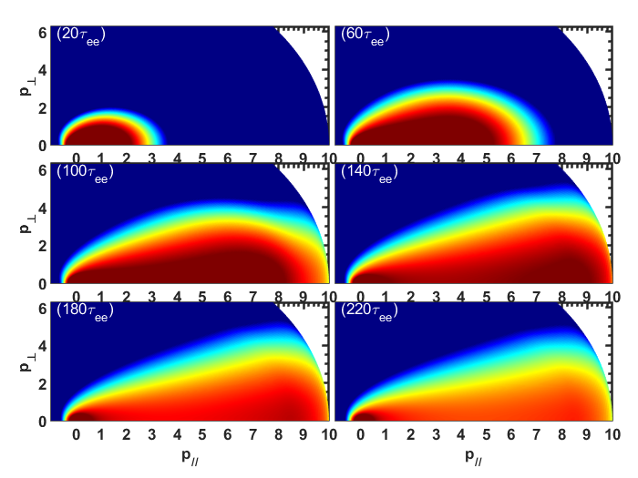
Kinetic simulation model
Code test
Momentum distribution evolution under static electric field
B=2.4T，$n_{e}={10}^{19} /m^{3}$, Te=10Kev, E=0.01V/M, $\frac{δB}{B}=0$

Slide 11
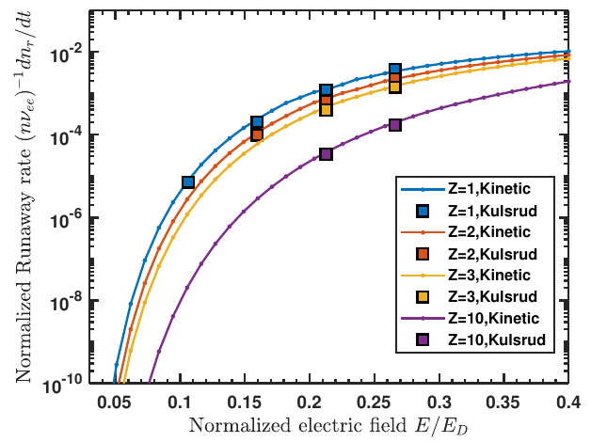
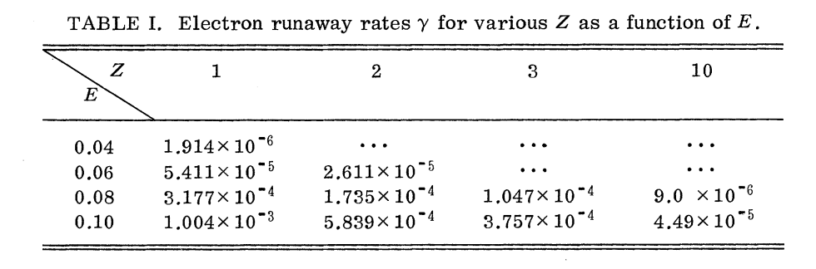
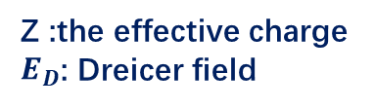
Kinetic simulation model
Code test
Runaway electron growth rate under different electric field
Z :the effective charge
$E_{D}$: Dreicer field
Consistency with the results by Kulsrud (1973)
Russell M. Kulsrud, ，Runaway Electrons in a Plasma*， PHYSICAL REVIEW LETTERS，1973

Slide 12

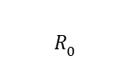
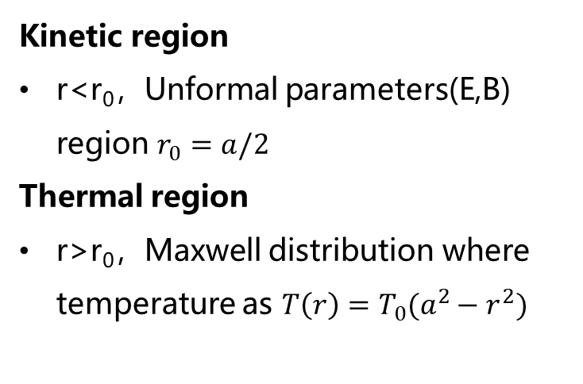

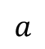
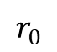
Application
Tokamak discharge analysis
The different region setup in Tokamak
Consider nonthermal electron only exist in core region
$$Z$$
Kinetic region
r<r0，Unformal parameters(E,B) region $r_{0}=a/2$
Thermal region
r>r0，Maxwell distribution where temperature as $T\left(r\right)=T_{0}(a^{2}−r^{2})$
Thermal region
$$r_{0}$$
Kinetic region
$$a$$
$$R_{0}$$
$$R$$
Chang Liu , “The effects of kinetic instabilities on the electron cyclotron emission from runaway electrons “,et al 2018 Nucl. Fusion 58 096030

Slide 13
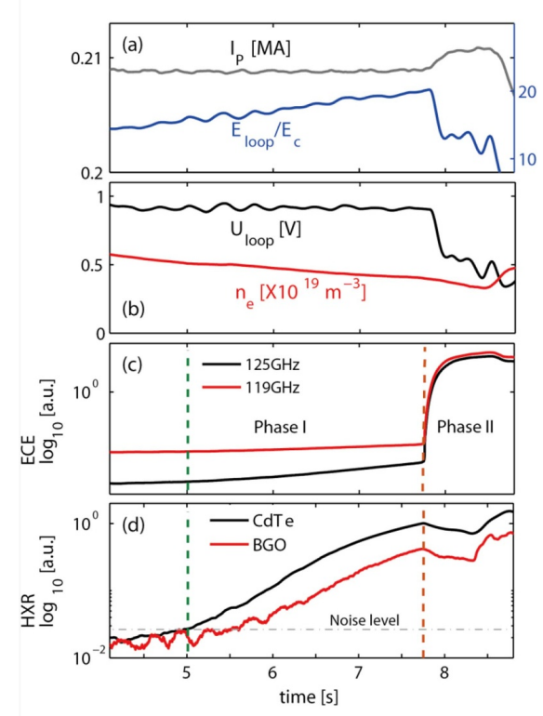
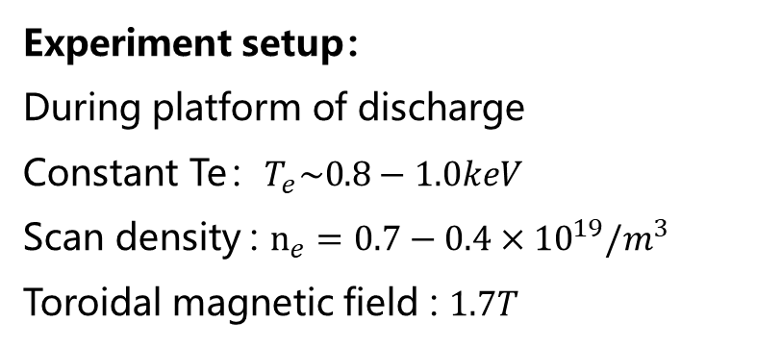
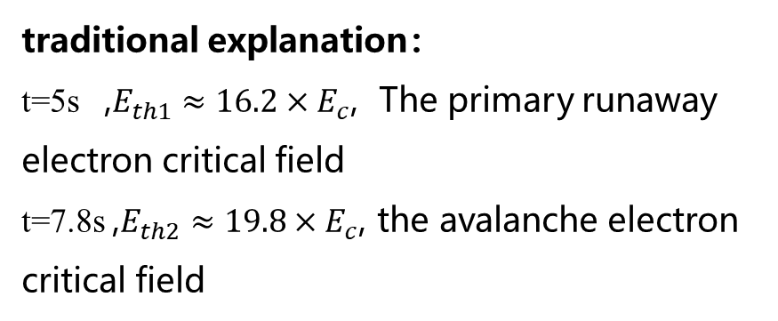
Application
EAST#53852 analysis
Experiment setup：
During platform of discharge
Constant Te：$T_{e}\sim 0.8−1.0keV$
Scan density : $n_{e}=0.7−0.4×{10}^{19}/m^{3}$
Toroidal magnetic field : $1.7T$
phenomenon：
t=5s , HXR linearly increases
t=7.8s , ECE growth exponentially
traditional explanation：
t=5s ,$E_{th1}≈16.2×E_{c}$, The primary runaway electron critical field
t=7.8s ,$E_{th2}≈19.8×E_{c}$, the avalanche electron critical field
X. Zhu , Observation of two threshold fields for runaway electron generation in tokamak,et al 2020 ,Nucl. Fusion ,60 084002

Slide 14
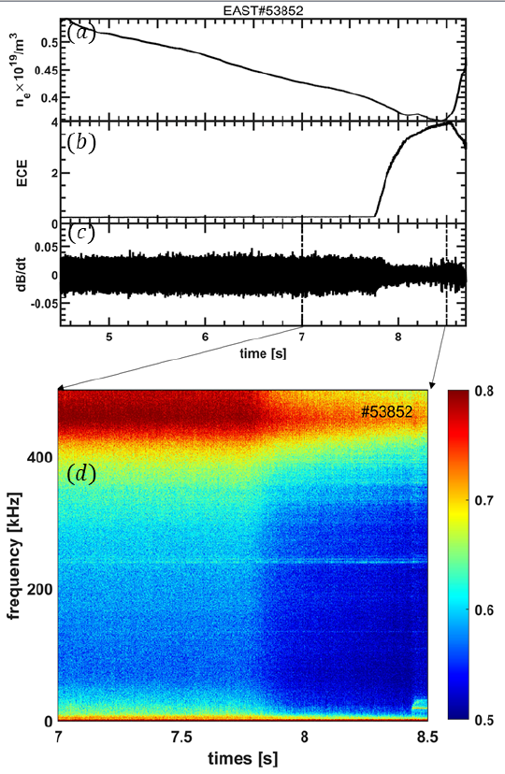
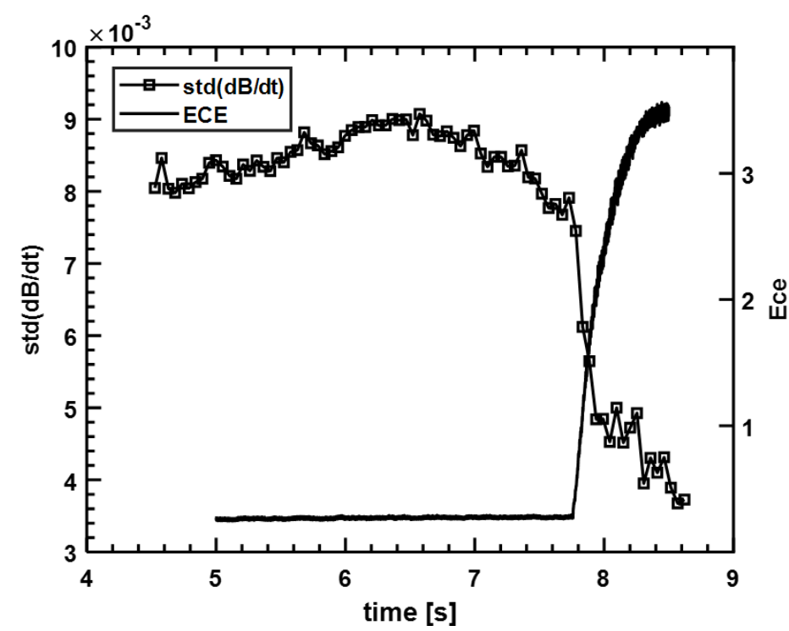
Application
Magnetic perturbation with ECE evolution
Magnetic perturbation decease ,ECE intensity increase
Does the electron cyclotron emission associate with magnetic perturbation？

Slide 15
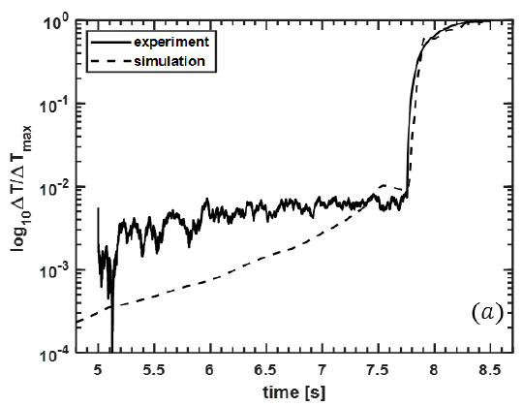
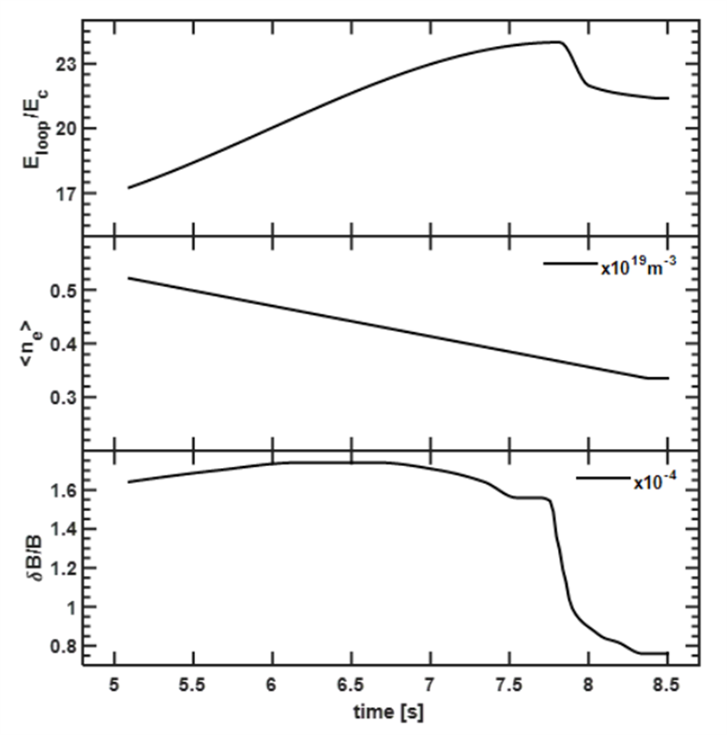
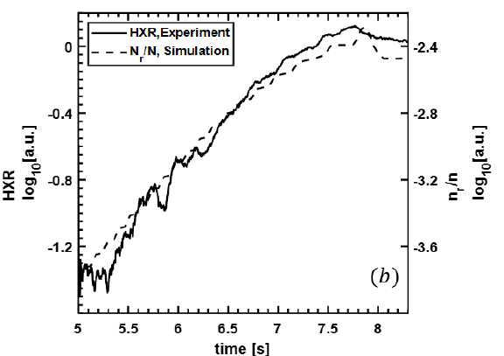
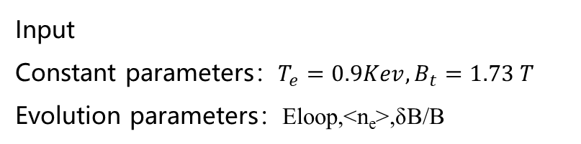
Application
Input
Constant parameters：$T_{e}=0.9Kev,B_{t}=1.73 T$
Evolution parameters：Eloop,<ne>,δB/B
ON

Slide 16
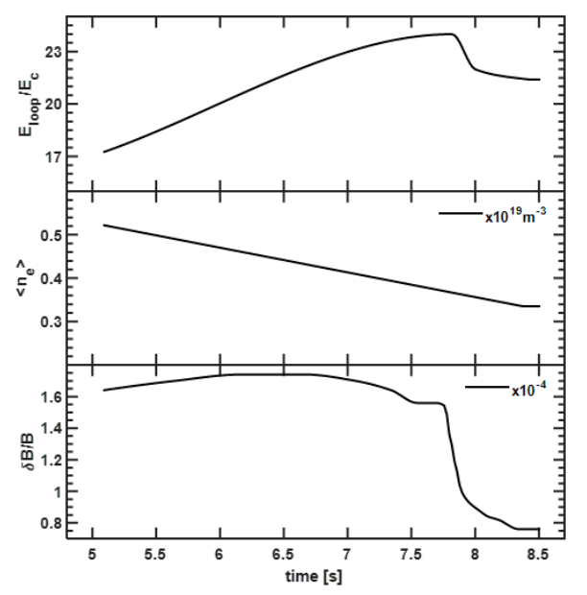
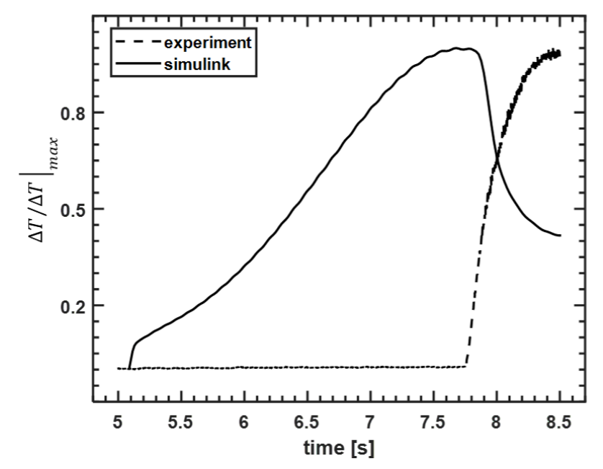
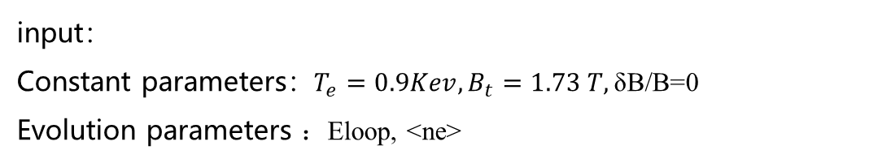
Application
input：
Constant parameters：$T_{e}=0.9Kev,B_{t}=1.73 T,\text{δB}\text{/}\text{B}$=0
Evolution parameters ：Eloop, <ne>
OFF
Without considering the magnetic perturbation ,The calculated ECE shape is quite different from the experiment

Slide 17
Brief summary
Develop ECE numerical diagnose
Develop Kinetic mode for non-thermal electron evolution
Combine the ECE model and Kinetic model to analyze ECE shape

Slide 18
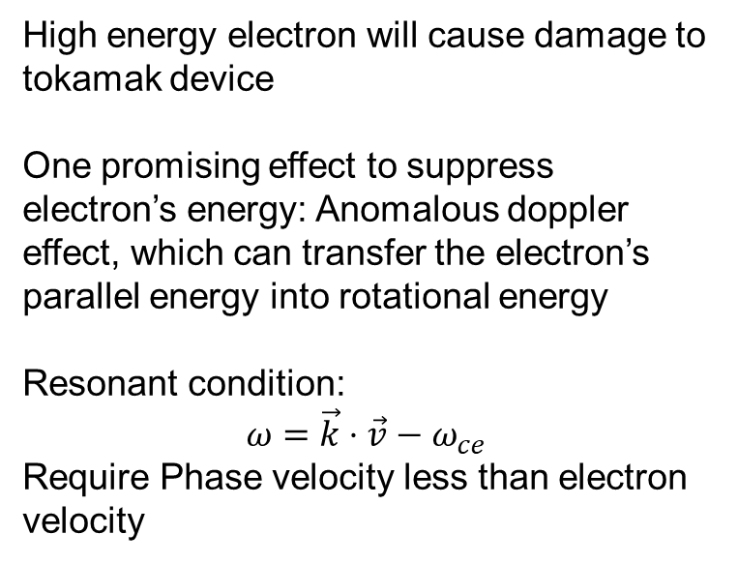
Suppress runaway electron energy
Free electron acceleration under static electric field
E=0.1V/m
High energy electron will cause damage to tokamak device
One promising effect to suppress electron’s energy: Anomalous doppler effect, which can transfer the electron’s parallel energy into rotational energy
Resonant condition:
$$ω=\vec{k}⋅\vec{v}−ω_{ce}$$
Require Phase velocity less than electron velocity
M. V. Nezlin, “Negative-energy waves and the anomalous doppler effect,”Soviet Physics Uspekhi 19, 946 (1976).

Slide 19
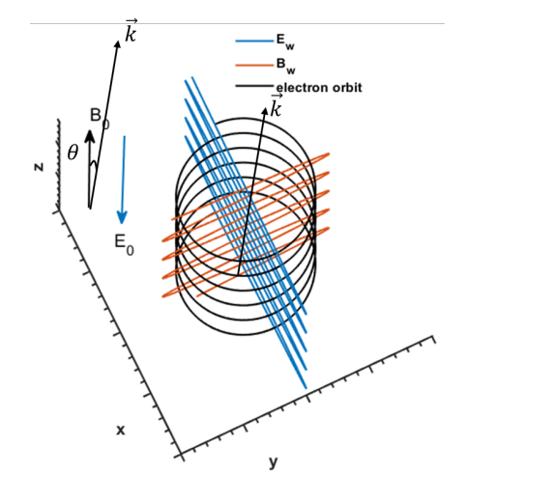
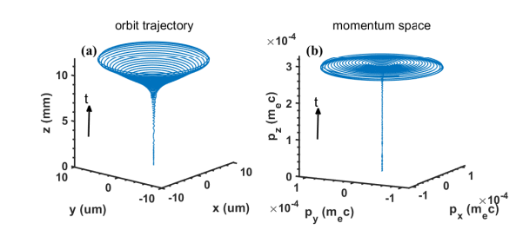
Simulation of electron’s motion with EMW
Background setup
results
it could continually transfer the electron’s parallel energy into rotational energy through Anomalous Doppler Resonance(ADR) when the electric field of the left circle polarization EMW surpassed a critical value

Slide 20
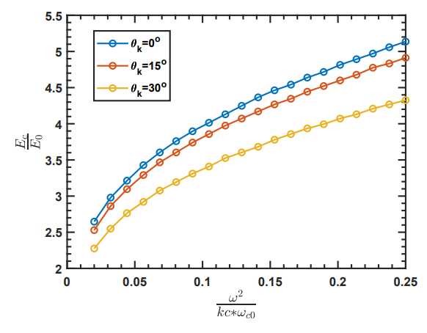

Slide 21
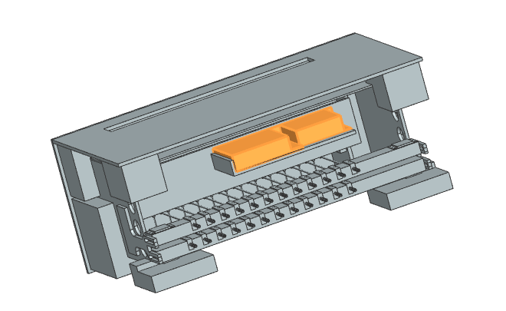
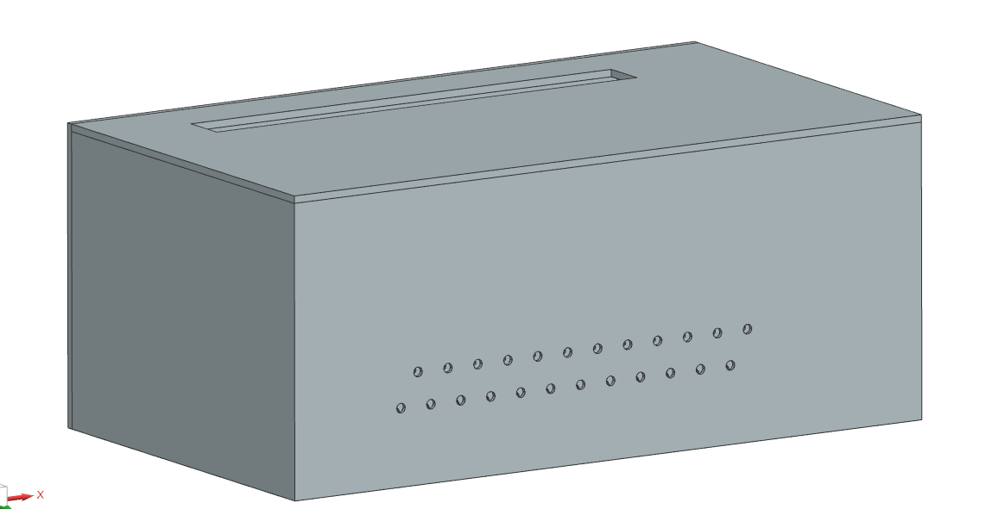
Redesign ECEI antenna structure to minimize size

Slide 22
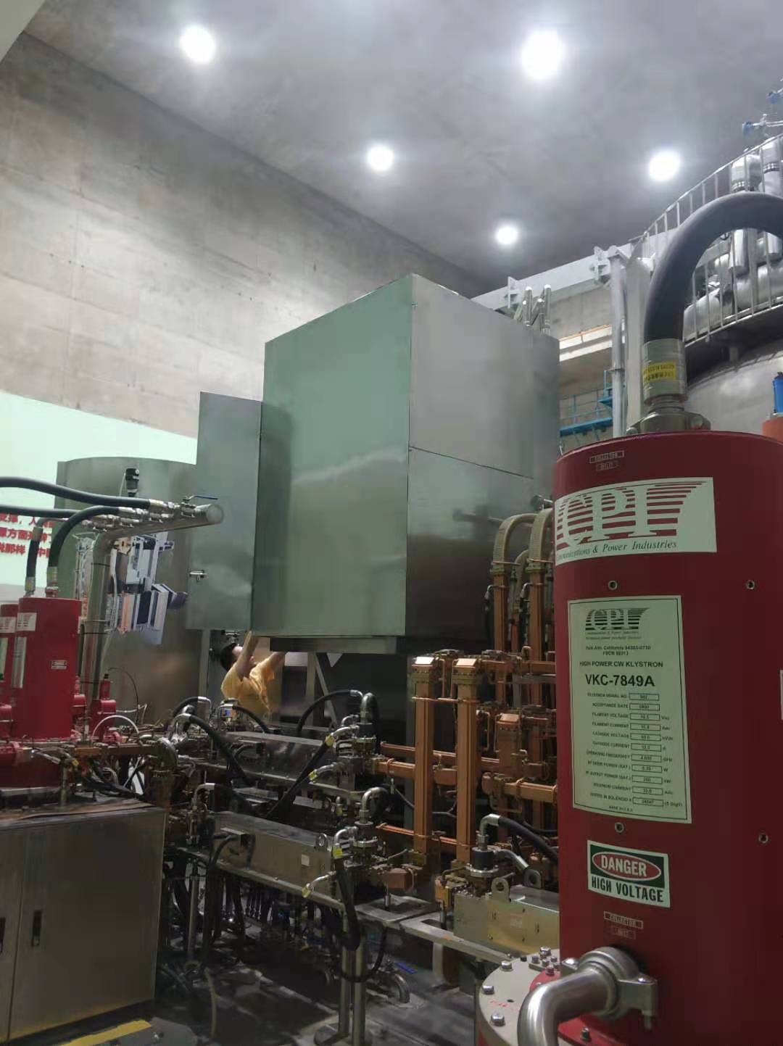
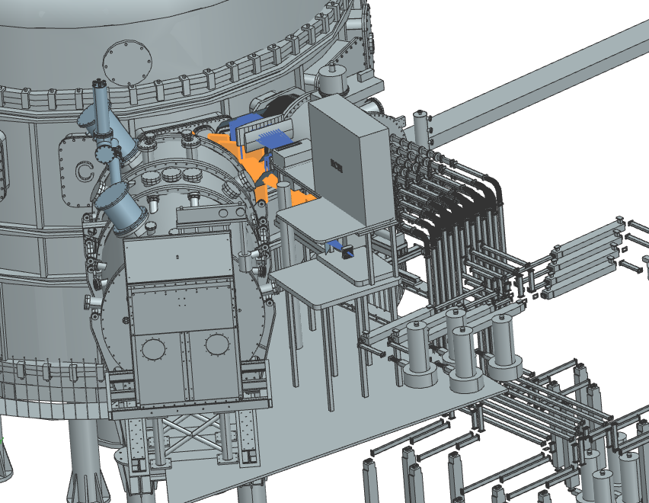
Design ECEI and MIR platform

Slide 23
Summary:
1.Develop code to analysis non-thermal emission
2.Find that the left circle wave can suppress electron parallel energy through ADE
3.Redesign the ECEI antenna
4.Build new ECEI&MIR platform and combine the ECEI and MIR system
…
Future:
Do my best on any project given to me

Slide 24
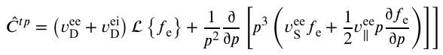

Fokker-Planck operator 𝐶[f]
The rate of angular scattering in electron-background electron and electron-background ion collision processes.
$$L=\frac{1}{2}\frac{∂}{∂ξ}\left(1−ξ^{2}\right)\frac{∂}{∂ξ}$$
HELANDER P, SIGMAR D J. Collisional transport in magnetized plasmas: volume 4[M]. Cambridge university press, 2005

Slide 25


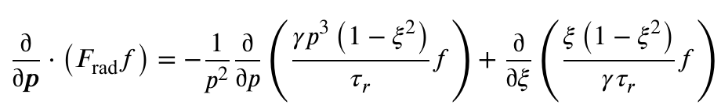
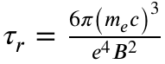
Radiation damping operator
Before 2015，particle number are not conserved
After 2015， particle number are conserved
Radiation damping caused by synchrotron radiation in the parallel direction
cyclotron radiation damping
where：
A.Stahl，Effective critical electric field for runaway-electron generation，Phys Rev Lett 2015
F. Andersson,Damping of relativistic electron beams by synchrotron radiation , Phys. Plasmas 8, 5221–5229 (2001)

Slide 26

磁扰动算符L[f]
由于随机磁扰动造成的逃逸电子径向输运损失算符可表示为
其中R表示装置大半经, a表示装置小半径, r表示小半径位置, q表示安全因子,
$v_{∥}$表示速度, γ表示洛伦兹因子
R. W. Harvey，Runaway electron production in DIII-D killer pellet experiments, calculated with the CQL3DÕKPRAD model，PHYSICS OF PLASMAS，2000

Slide 27
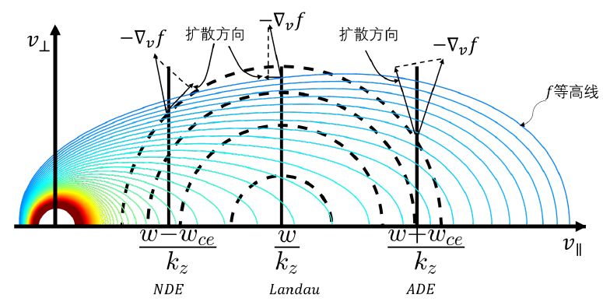
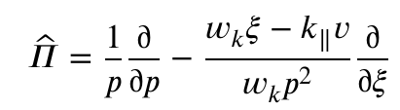
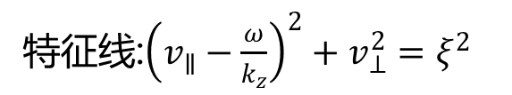

电磁湍动算符D[f]
算符
特征线:${\left(v_{∥}−\frac{ω}{k_{z}}\right)}^{2}+v_{⊥}^{2}=ξ^{2}$
电磁波与电子共振关系$ω=\vec{k}⋅\vec{v}+nω_{ce}$
多普勒共振$v_{∥}=\frac{ω−ω_{ce}}{k_{z}}$
朗道共振$v_{∥}=\frac{ω}{k_{z}}$
反常多普勒共振$v_{∥}=\frac{ω+ω_{ce}}{k_{z}}$
不同共振条件下电子速度演化方向
T. H. Stix,Waves in plasmas, Springer Science & Business Media 1992

Slide 28


EMBREUS雪崩算符
逃逸电子受背景热电子碰撞后分布函数的变化
热电子受逃逸电子碰撞后分布函数的变化
雪崩电子算符首次具有密度守恒，动量守恒、能量守恒等优良性质。传统Rosenbluth雪崩算符假设逃逸电子速度无穷大， Chiu–Harvey 模型中考虑逃逸速度分布但假设逃逸电子速度的投掷角为零
ROSENBLUTH M N ，Nuclear Fusion, 1997, 37(10)
CHIU S ,Nuclear Fusion, 1998
EMBREUS O ,Journal of Plasma Physics, 2018, 84(1)

